Slide 1

PYTHON FOR MACHINE LEARNING
TEAM - 13

Slide 2

TEAM MEMBERS
PRAGADISHWARAN K
NALIN M R
CB.EN.U4AIE.20029
CB.EN.U4AIE.20029
KARTHIKEYAN M
KARTHIK RAJA B
CHANDU JANAKIRAM
CB.EN.U4AIE.20029
CB.EN.U4AIE.20029
CB.EN.U4AIE.20029

Slide 3
01
INTRODUCTION
KNN
03
CNN
SVM
02
04
K-NEAREST NEIGBOR
CONVOLUTIONAL NEURAL NETWORK
SUPPORT VECTOR MACHINE
DNN
05
DEEP NEURAL NETWORKS

Slide 4
Remote sensing image classification using ML

Slide 5
01
INTRODUCTION

Slide 6
Introduction
Satellite imagery has a wide range of applications which is incorporated in every aspect of human life.
Especially remote sensing has evolved over the years to solve a lot of problems in different areas.
In Remote Sensing, hyperspectral remote sensors are widely used for monitoring the earth’s surface
with a high spectral resolution.
Hyperspectral Imaging is an important technique in remote sensing, which collects the electromagnetic
spectrum ranging from the visible to the near-infrared wavelength. Hyperspectral imaging sensors often
provide hundreds of narrow spectral bands from the same area on the surface of the earth. In
hyperspectral images (HSI), each pixel can be regarded as a high-dimensional vector whose entries
correspond to the spectral reflectance in a specific wavelength.
With the advantage of distinguishing subtle spectral differences, HSIs have been widely applied in
diverse areas such as Crop Analysis, Geological Mapping, Mineral Exploration, Defence Research, Urban
Investigation, Military Surveillance, Flood Tracking, etc.

Slide 7
Remote Sensing Image Classification
Remote sensing image scene classification, which aims to classify remote sensing image into different types based on image content, has been attracted more and more attentions for its comprehensive application in fields of geography, ecology, city plan, forest monitor, military, etc .
Remote sensing image scene classification essentially belongs to domains of machine learning and computer vision. With well-organized training dataset, models can be learned through minimizing loss functions between model output and ground-truth label.
With explosive increasing of remote sensing data, analysis and processing remote sensing image effectively and efficiently becomes of great importance.

Slide 8

What is Image Classification in Remote Sensing?
The 3 main types of image classification techniques in remote sensing are:
Unsupervised image classification
Supervised image classification
Object-based image analysis
Unsupervised and supervised image classification are the two most common approaches.
However, object-based classification has gained more popularity because it’s useful for high-resolution data.

Slide 9
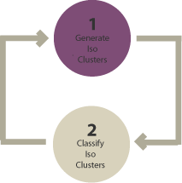
Unsupervised Classification
In unsupervised classification, it first groups pixels into “clusters” based on their properties. Then, you classify each cluster with a land cover class.
Overall, unsupervised classification is the most basic technique. Because you don’t need samples for unsupervised classification, it’s an easy way to segment and understand an image.
The two basic steps for unsupervised classification are:
Generate clusters
Assign classes

Slide 10
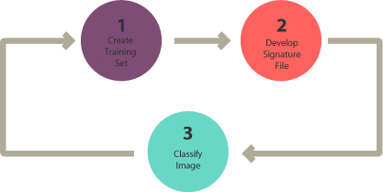
Supervised Classification
In supervised classification, you select representative samples for each land cover class. The software then uses these “training sites” and applies them to the entire image.
The three basic steps for supervised classification are:
Select training areas
Generate signature file
Classify

Slide 11
Supervised Classification
For supervised image classification, you first create training samples. For example, you mark urban
areas by marking them in the image. Then, you would continue adding training sites representative
in the entire image.
For each land cover class, you continue creating training samples until you have representative
samples for each class. In turn, this would generate a signature file, which stores all training samples
spectral information.
Finally, the last step would be to use the signature file to run a classification. From here, you would
have to pick a classification algorithms such as:
Maximum likelihood
Minimum-distance
Principal components
Support vector machine (SVM)
Iso cluster

Slide 12
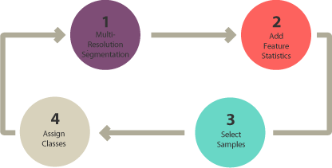
Object-Based Image Analysis (OBIA)
Supervised and unsupervised classification is pixel-based. In other words, it creates
square pixels and each pixel
has a class. But object-based image classification groups pixels into representative
vector shapes with size and
Geometry.
Here are the steps to perform object-based image analysis classification:
Perform multiresolution segmentation
Select training areas
Define statistics
Classify

Slide 13
CONVOLUTIONAL NEURAL NETWORK
02

Slide 14
Convolutional Neural Network (CNN)
Deep learning is a subset of machine learning that yields high-level abstractions by compositing multiple
non-linear transformations. Among deep learning algorithms, Convolutional Neural Networks (CNNs) have
gained popularity in computer vision and remote sensing fields, especially for image classification.
Convolutional Neural Networks (CNN) is a type of deep learning method that uses convolutional
multiplication based on artificial neural networks. Recently, CNN has been widely used in land cover
classification, showing remarkable performance. Typical CNNs are composed of convolutional layers, pooling
layers, and fully connected layers.
CNN is a deep learning network with following benefits over models: CNNs uses a convolution procedure onthe pixels of an image to retrieve the image's features. CNN can display image data, and gather image information from large data easily.

Slide 15
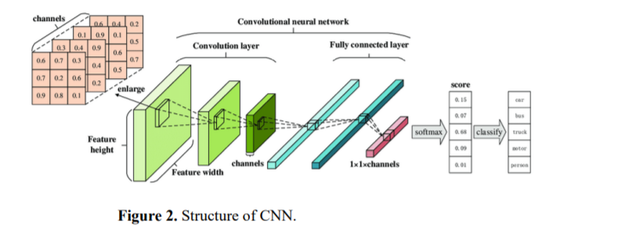
CNNs specifically learn to analyze two-dimensional (2D) shapes that transform the original input into the output. Inside a CNN, each neuron is connected within the preceding layer neurons, thereby reducing weights in the network. As shown in the Figure , this network consists of the convolutional layer, pooling layers and a fully connected output layer. The results of the classification are generated from the final output layer.
A CNN's core layer is the convolutional layer . The convolution kernel/filter is an array of weight matrix. The characteristic map formed by convolving the input matrix and filter can be the input for the convolutional neural network's successive stages. Furthermore, the neurons in each input image convolve with the kernel in every convolutional layer. A CNN can have any number of convolutional layers

Slide 16
Steps involved in CNN based classification
Step 1: Choose a Dataset
Step 2: Prepare Dataset for Training
Step 3: Create Training Data
Step 4: Shuffle the Dataset
Step 5: Assigning Labels and Features
Step 6: Normalising X and converting labels to categorical data.
Step 7: Split X and Y for use in CNN
Step 8: Define, compile and train the CNN Model
Step 9: Accuracy and Score of model

Slide 17
03
K-NEAREST NEIGHBOR

Slide 18
K –Nearest Neighbour(KNN)
K-nearest neighbor (KNN) is a common classification method for data mining techniques. It has been
widely used in many fields because of the implementation simplicity, the clarity of theory and the
excellent classification performance. But KNN will increase classification error rate when training
samples distribute unevenly or sample number of each class is very different. So, learning from the
idea of clipping-KNN, we adopt an improved KNN classification algorithm and applies it to
object-oriented classification of high resolution remote sensing image.
Firstly, as sample points, image objects are obtained through image segmentation.
Secondly, original KNN, clipping-KNN and the improved KNN are introduced and used to classify those sample points respectively.
kNN provides objective, fast, transparent and produces good results over larger areas. The main advantage of kNN algorithm is its simplicity and lack of parametric assumptions

Slide 19
WORKING OF KNN ALGORITHM
After the model has stored the training set for prediction, it takes a test image to be predicted, calculates the distance to every image in the training set and obtains the ‘k’ training images closest to the test image. It then outputs the class according to some voting procedure from the labels of these ‘k’ neighbours , generally a majority vote.
As k-NN is a very simple algorithm it doesn’t really have a lot of hyperparameters to tweak, just the two: the distance metric and the value of ‘k’. So what we can do is, run our model for various values of ‘k’ and get the model with the best validation accuracy, which will be used as our final model on the test set.
The model only consists of the training data, that is, the model simply learns the entire training set and for prediction gives the output as the class with the majority in the ‘k’ nearest neighbours calculated according to some distance metric.

Slide 20
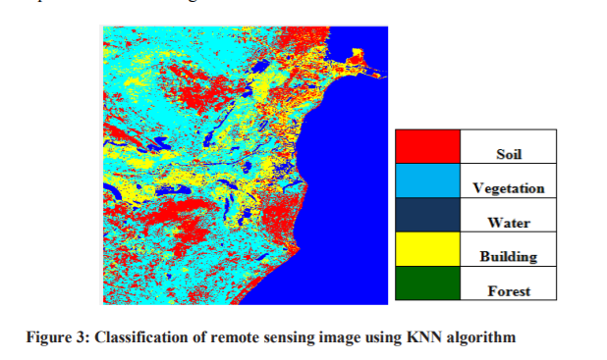
Example : If an unknown sample and known training data are taken and the distances between all training set samples and unknown samples will be calculated. The smallest distance value corresponds to their training set sample which are close to unknown sample. Thus the unknown sample can be classified on the basis of their nearest neighbour. It is highly required for the extraction of edges which is to be completely connected as there are several features values and the objects co-existing in different shapes and sizes in satellite images (LANSAT 8). The measurement of smoothness technique of an image by using Gradian operators and criterion of Euclidean is evaluated .

Slide 21
04
SUPPORT VECTOR MACHINE

Slide 22
SUPPORT VECTOR MACHINE
Support Vector Machine(SVM) is a supervised machine learning algorithm used for both classification and regression. Though we say regression problems as well its best suited for classification.
The objective of SVM algorithm is to find a hyperplane in an N-dimensional space that distinctly classifies the data points. The dimension of the hyperplane depends upon the number of features. If the number of input features is two, then the hyperplane is just a line.
If the number of input features is three, then the hyperplane becomes a 2-D plane. It becomes difficult to imagine when the number of features exceeds three.

Slide 23
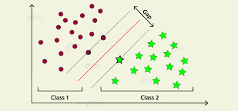
SUPPORT VECTOR MACHINE
A support vector machine constructs a hyper-plane or set of hyper-planes in a high or infinite dimensional space, which can be used for classification, regression or other tasks. Intuitively, a good separation is achieved by the hyper-plane that has the largest distance to the nearest training data points of any class (so-called functional margin), since in general the larger the margin the lower the generalization error of the classifier. The figure below shows the decision function for a linearly separable problem, with three samples on the margin boundaries, called “support vectors”

Slide 24
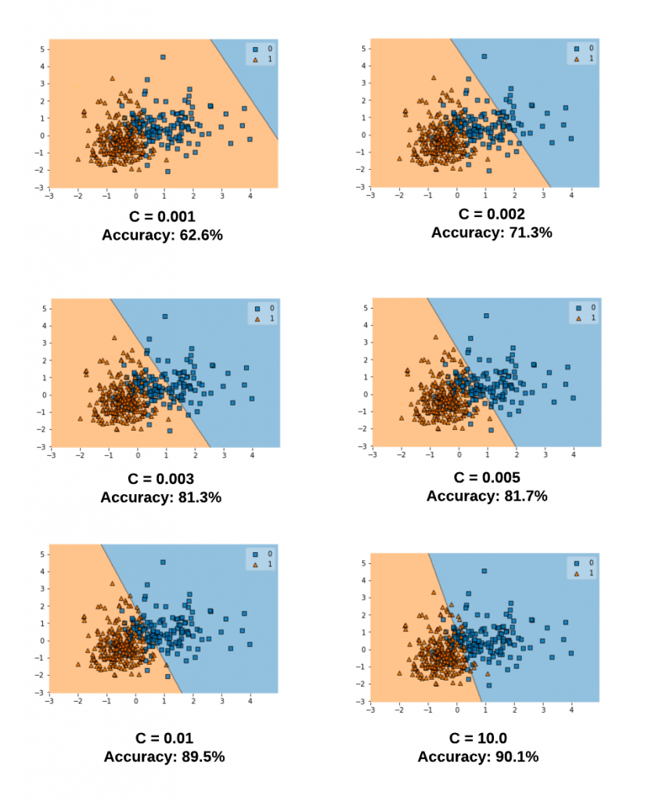
SVM SEGREGATION
The Support Vector Machine (SVM) classification process is based on finding an optimal separation hyperplane performing the minimum distance.
The optimal hyperplane is defined by a subset of feature vectors from the learning database named Support vectors denoted V. The classification problem is equivalent to a quadratic optimization with constraints The optimization problem is parameterized by a penalty parameter C that describes the separation complexity and the classification error.

Slide 25
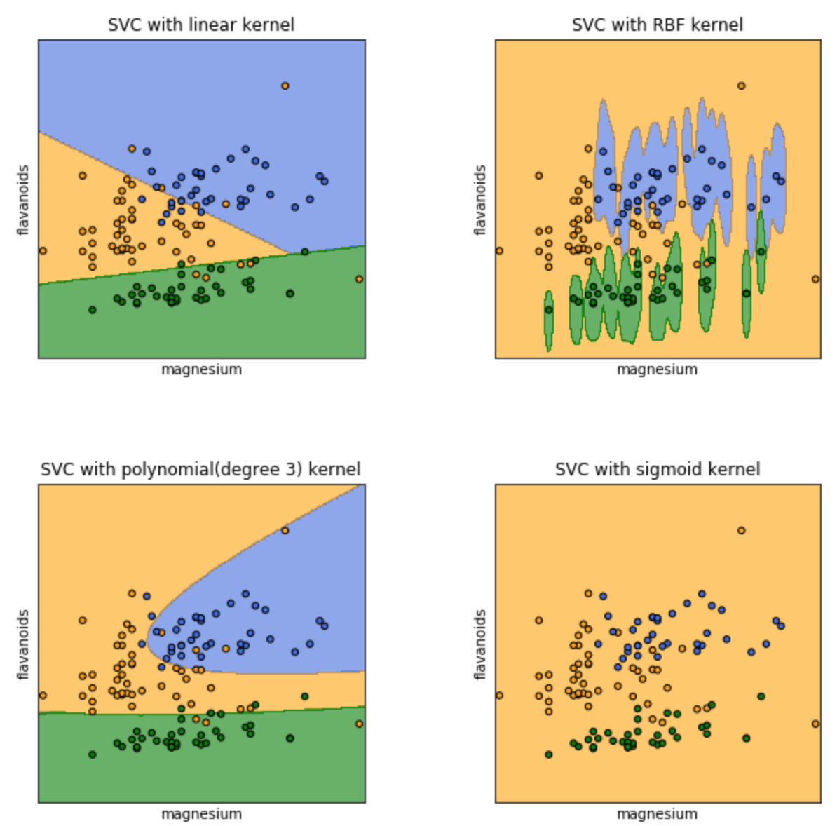
SVM KERNELS
When the separability is nonlinear , a nonlinear transform from the feature space to a new space with greater dimension allows a linear separability. There is no need to find the transform function, only a kernel function K is needed. The kernel choice is determinative for the separability and depends on the classification application.
DIFFERENT KERNELS:
1. Linear Kernel
2. Polynomial Kernel
3. Sigmoid Kernel
4. Gaussian Kernel
5. Bessel function kernel
6. ANOVA kernel
7. Radial Basis Function kernel

Slide 26
STEPS INVOLVED IN SVM BASED CLASSIFICATION
It is a non-probabilistic model in which the dataset is trained using a trainer. The number of regions are mapped together and mainly used in image segmentation and classification purpose to identify the features. It helps in finding accurate and better results in classification purpose. It includes following stages:
► First of images are preprocessed
►Dividing the database into test set and training set
► choose data for input
►then training method is selected that includes:
• Multi class training
• Choose Kernel
►Train the dataset
►Test and evaluate the performance

Slide 27
Advantages of SVM:
Effective in high dimensional cases
Its memory efficient as it uses a subset of training points in the decision function called support vectors
Different kernel functions can be specified for the decision functions and its possible to specify custom kernels

Slide 28
DEEP NEURAL NETWORKS
05

Slide 29
What is DNN?
A neural network is a series of algorithms that endeavors to recognize underlying relationships in a set of data through a process that mimics the way the human brain operates. ... Neural networks can adapt to changing input; so the network generates the best possible result without needing to redesign the output criteria.

Slide 30
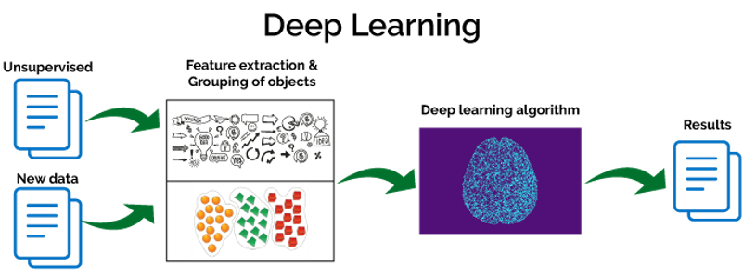
--

Slide 31
ADVANTAGES OF DNN
One of the main advantages of deep learning lies in being able to solve
complex problems that require discovering hidden patterns in the data and/or
a deep understanding of intricate relationships between a large number of
interdependent variables.

Slide 32
IMPLEMENTATION

Slide 33

THANK YOU

